Slide 1

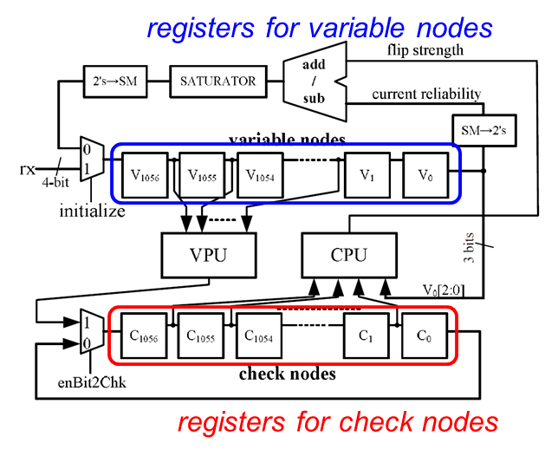
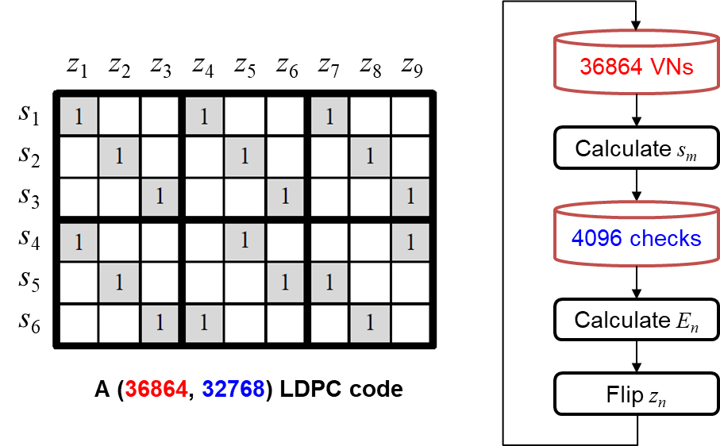
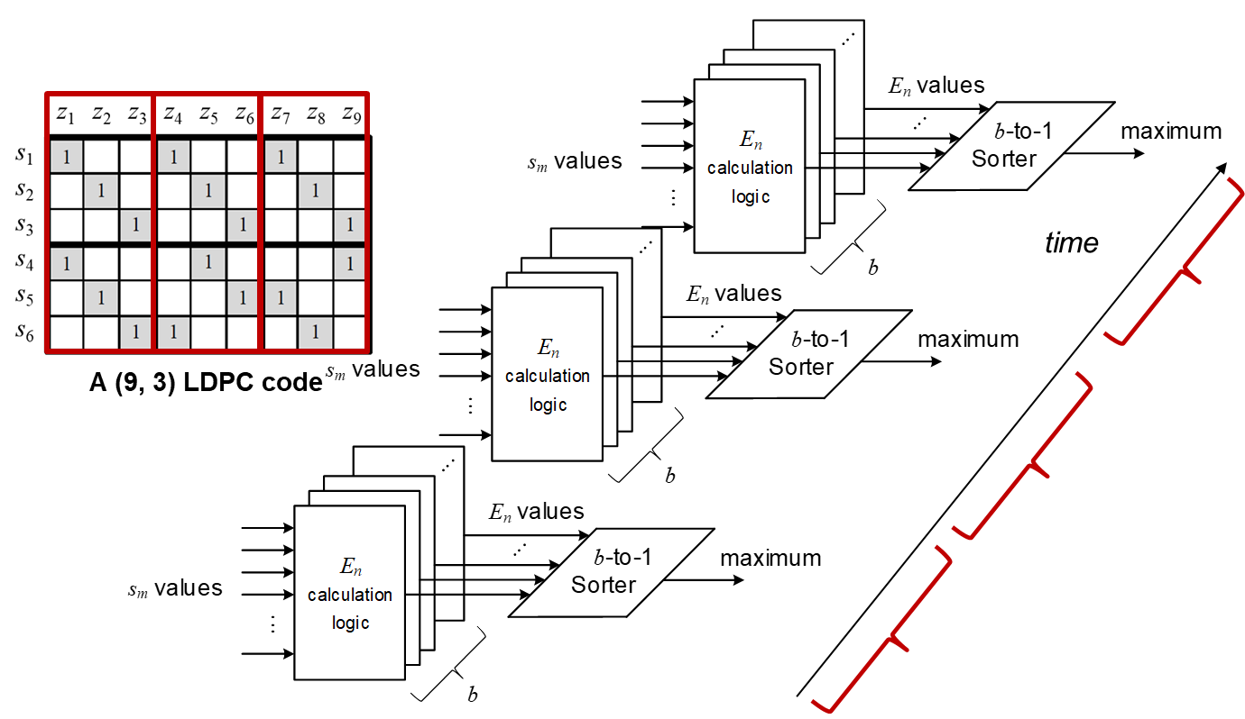
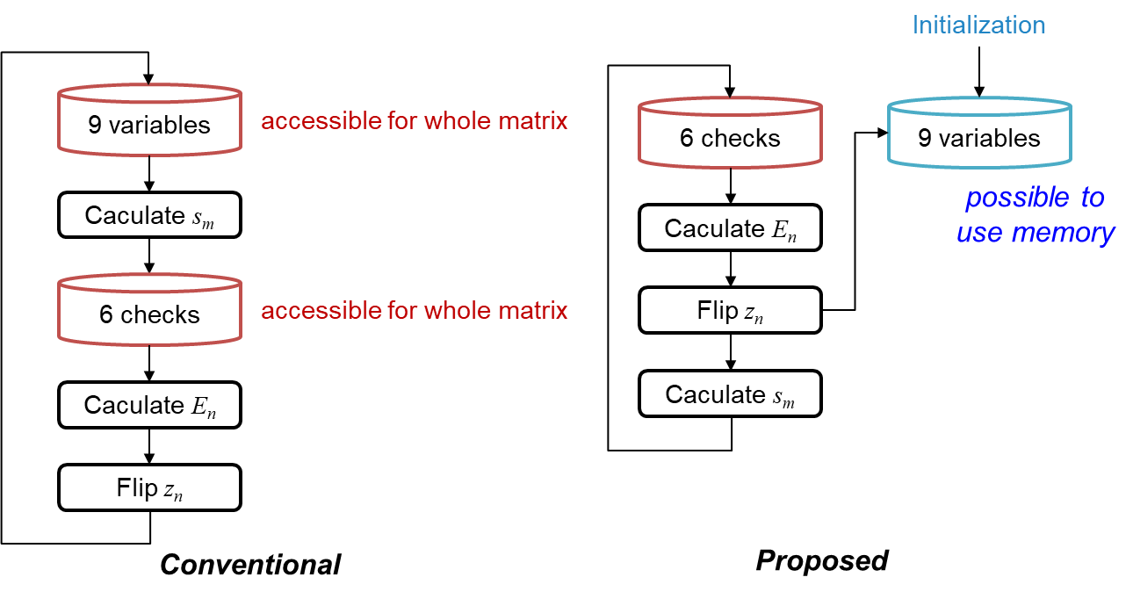
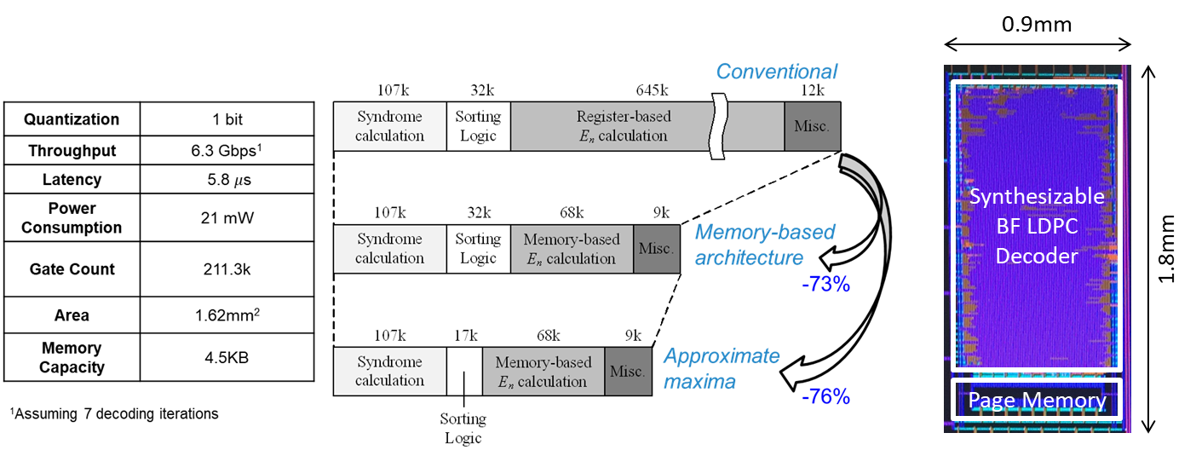
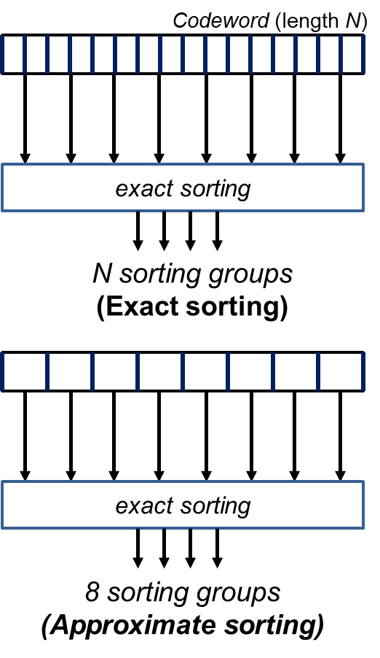
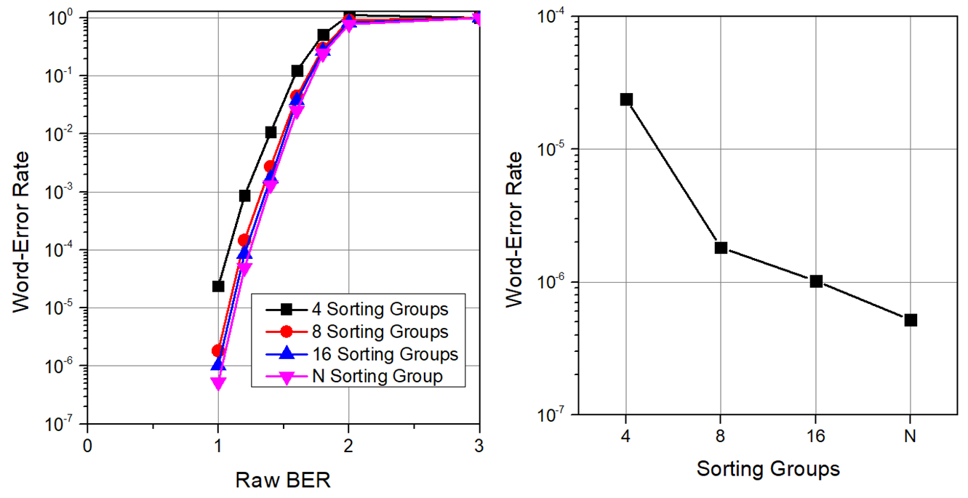
2020 IDEC Congress CDC
Low-Complexity Memory-Based
Bit Flipping LDPC Decoding Architecture
Jaehwan Jung and In-Cheol Park
School of Electrical Engineering, KAIST
Summary
Bit Flipping LDPC (BF LDPC) decoders are conventionally implemented with a register array.
Memory-based BF LDPC decoding architecture is proposed to relax the hardware complexity.
The proposed memory-based architecture reduces the area up to 76% compared to the conventional register-based architecture.
1. Conventional BF LDPC Decoding Architecture
4. Decoding Architecture
Conventional implementation of BF LDPC decoders
Power-hunger architecture due to the use of registers
Impractical hardware complexity for long LDPC codes
Memory-based BF LDPC decoding architecture
Syndrome calculation & update logic
Voting value calculation
Permuter & Sorter
Incremental calculation logic
Approximate sorting logic
Incremental calculation of voting values
①
②
③
2. Proposed Memory-Based Architecture
Proposed BF LDPC decoding architecture
Not storing both variable and check node values in registers
Calculate voting values and update syndromes immediately
③
②
①
5. Implementation Result
A BF LDPC decoder for a (36864, 32768) LDPC code
Technology: Samsung 65nm CMOS
Working frequency: 200MHz
Reducing the area up to 76% compared to the conventional register-based decoding architecture
3. Approximate Sorting
Approximate sorting method
Relax hardware complexity by grouping variable nodes
Negligible decoding performance degradation
6. Acknowledgement
This work was supported by the IC Design Education Center (IDEC).
Paper No. 202003057 / 2020 IDEC Congress CDC

